Slide 1
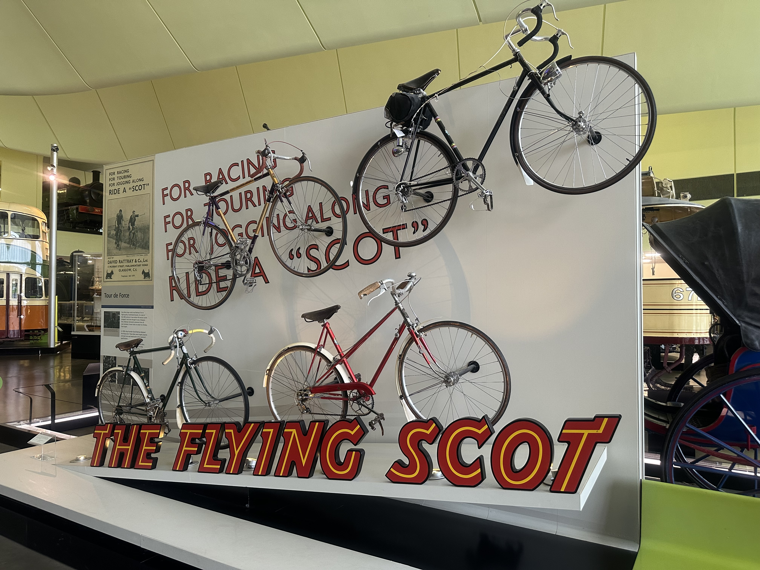
THE FLYING SCOTS
The Flying Scot bikes were first built in 1901 by David Rattray and Co. in Glasgow. Rattray was probably the largest maker of lightweight bicycles in Scotland. Rattray went out of business in 1982

Slide 2
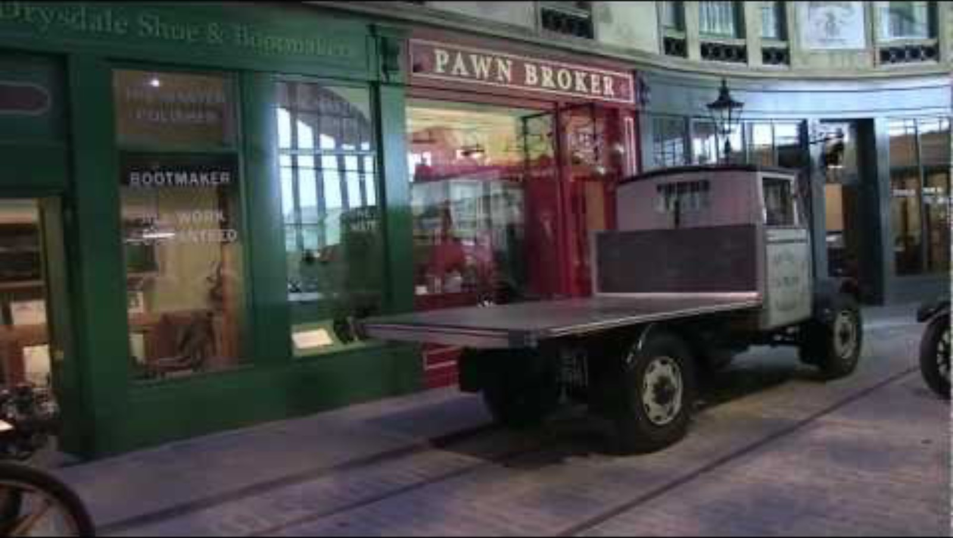

Slide 3
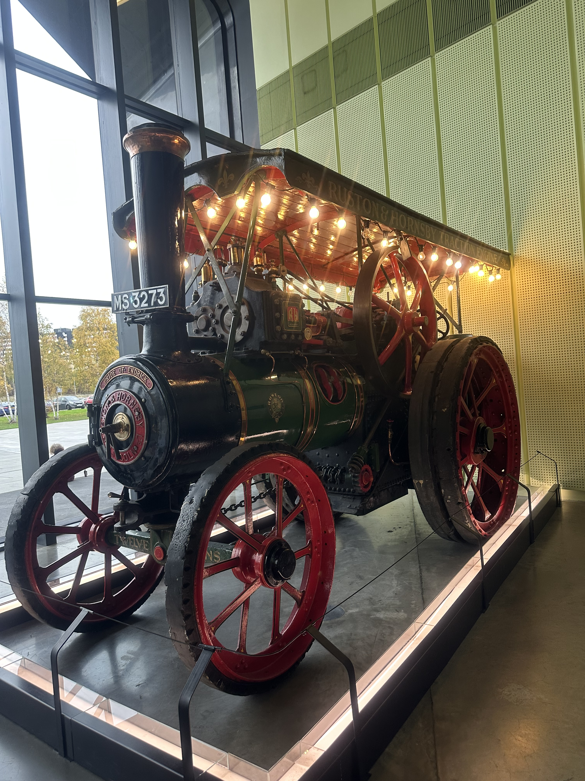
Thomas Savery is considered the inventor of the first commercially used steam powered device, a steam pump that used steam pressure operating directly on the water. The first commercially successful engine that could transmit continuous power to a machine was developed in 1712 by Thomas Newcomen.T
This steam –powered traction engine was used in agriculture. Showpeople also used transaction engines to haul wagons and rides and to power them. Built by RUSHTON 1920.

Slide 4
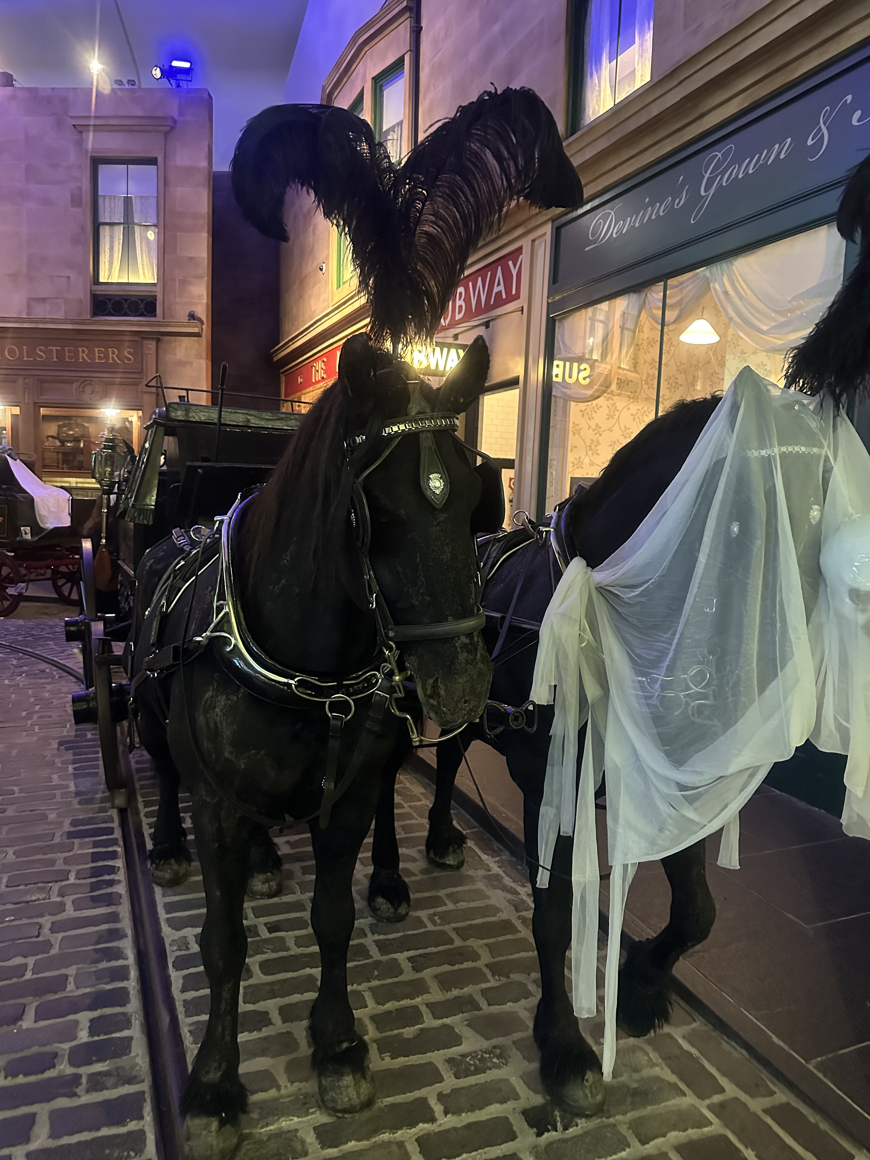
Vehicles on Main Street
Horse drawn hearse
About 1875 by

Slide 5
150 Years Since Glasgow’s First Horse-drawn Tramway Began Operating
Aug 19, 2022 | Curator's Choice, Latest News, Tramway Anniversaries
150 years ago today, on 19th August 1872, Glasgow’s first horse-drawn tramway began to operate. Its first line ran from St. George’s Cross to Eglinton Toll, via New City Road and Jamaica Bridge. The tramway was operated by the Glasgow Tramway and Omnibus Company and was the second horse-drawn tramway to open in Scotland – Edinburgh’s first line having opened on 6th November 1871.

Slide 6
END OF THE EXHIBIT
THANK YOU FOR YOUR ATTENTION

